Slide 1
Secure data hiding in images using steganography
Protecting Data From Hackers
Presented By: Akshat Shrivastava
College Name: Oriental College Of Technology Department: Electronics & Communication Engineering

Slide 2
OUTLINE
Problem Statement
Technology used
Wow factor
End users
Result
Conclusion
Git-hub Link
Future scope

Slide 3
Problem Statement
The increasing reliance on digital communication necessitates robust methods for secure data transmission. Traditional encryption methods can attract unwanted attention, while simply transmitting data in plain sight is vulnerable to interception.
Therefore, there is a critical need to develop and enhance steganographic techniques that can effectively conceal sensitive information within digital images, ensuring both confidentiality and imperceptibility, while also maximizing data capacity and minimizing detectability to maintain secure communication.

Slide 4
Technology used
Programming Languages:
Python (for image processing and scripting)
Libraries/Tools:
OpenCV (image manipulation, pixel access)
Open Stego (steganography tool)
Steganographic Algorithms:
LSB (Least Significant Bit embedding)
Patchwork (statistical data hiding)
Security:
AES (Advanced Encryption Standard)

Slide 5
Wow factors
Minimal Image Distortion: Hidden data is virtually undetectable.
User-Friendly Interface: Easy to use, even for non-experts.
Secure Communication: Protects sensitive data in critical applications.
Forensic Applications: Aids in digital investigations.
Open-Source Potential: Encourages community development.

Slide 6
End users
Journalists/Whistleblowers: Secure communication.
Activists/Human Rights: Discreet information sharing.
Law Enforcement/Military: Covert data transfer.
Privacy-Conscious Users: Personal data protection.
Photographers/Artists: Copyright/ watermarking.
Healthcare/Finance: Secure data transmission.
Cybersecurity Professionals: Testing/incident response.

Slide 7
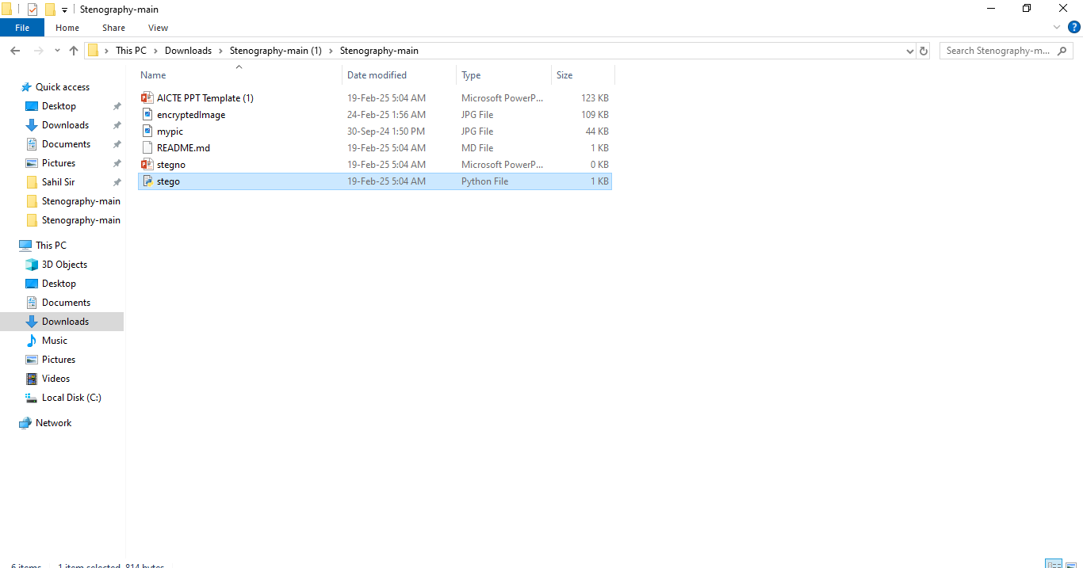
Results

Slide 8
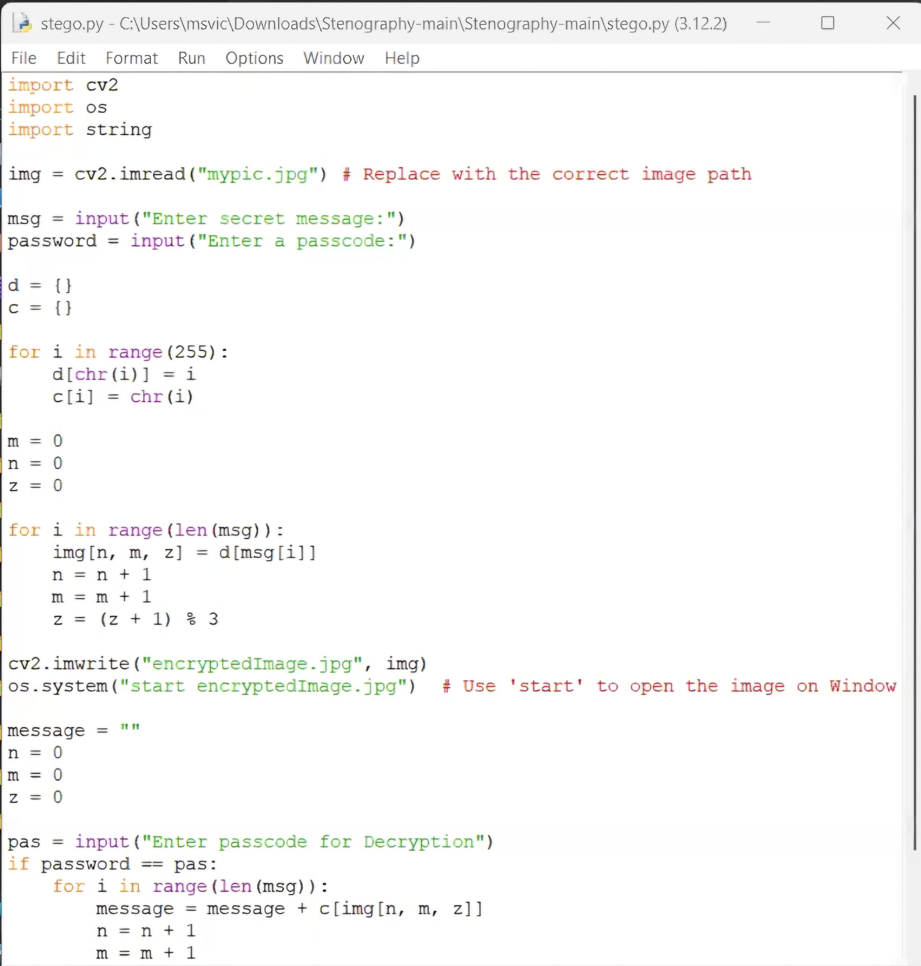

Slide 9
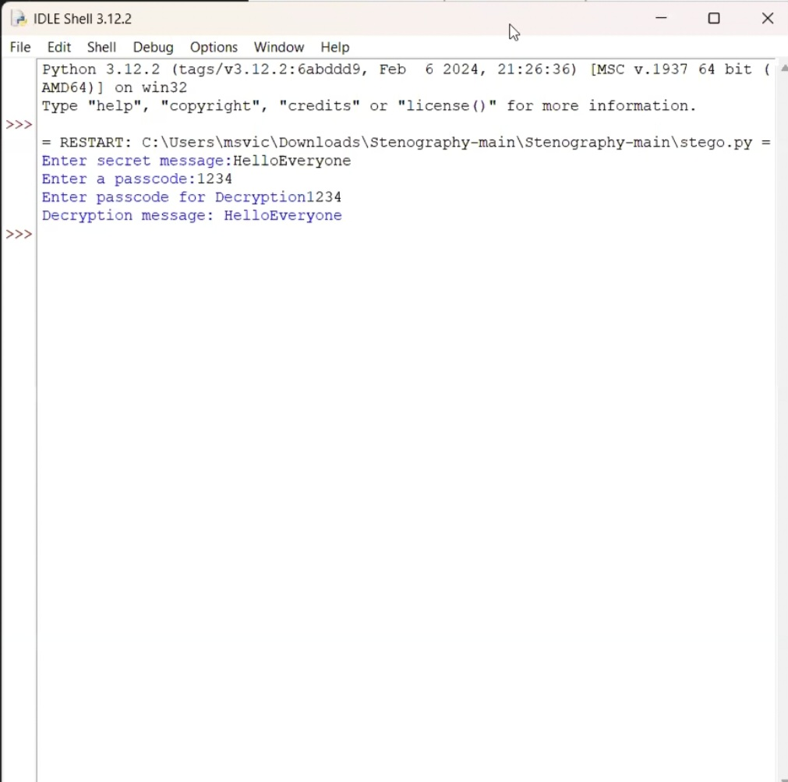

Slide 10
Conclusion
This project demonstrated the feasibility of robust steganography through the implementation of LSB, Python , OpenCV. The virtually undetectable data hiding, enhanced by AES encryption, coupled with a user-friendly design, provides secure communication for privacy-conscious users, law enforcement & the healthcare sector.

Slide 11
GitHub Link
https://github.com/Akshat033692/IBM-PROJECT.git

Slide 12
Future scope(optional)

Slide 13
THANK YOU

